Slide 1
Technical Roles

Slide 2
Job Families
Front End
Back End
Full Stack
Dev Ops
Technology Specific

Slide 3
Front End
Website/Web Applications
Controlling how elements are presented on the screen
Communicating with internal/external APIs
Technologies: React, Angular, Vue, Django, Ruby on Rails, Webpack
Languages: JS, TypeScript, Python, Ruby, etc.

Slide 4
Back End
Building APIs
Building services that manage data and business rules
Integrating services to make decisions about the data
Technologies: Spring, Node, .Net, Docker, K8
Languages: Java, JS, TypeScript, C#, etc. (really anything)

Slide 5
Full Stack
Combines both Front/Back end
More common at smaller companies
Someone who is comfortable with a breadth of technology
Technologies: All
Languages: All

Slide 6
Dev Ops (Site Reliability Engineer/SRE)
Provisioning infrastructure for software applications
Server, network, and database config via infrastructure as code
Creating tools for developers (CI/CD Pipelines, security, etc.)
Usually favor one cloud (GCP vs. AWS vs. Azure)
Technologies: Terraform, Cloudformation, Docker, K8
Languages: YAML, Bash, Python, Go

Slide 7
Technology Specific
Expert in one piece of technology
Usually a widely used vendor product or cloud service
Often done as part of a consulting type role
Examples: AWS/Azure, SAP, Salesforce, MuleSoft, etc.

Slide 8
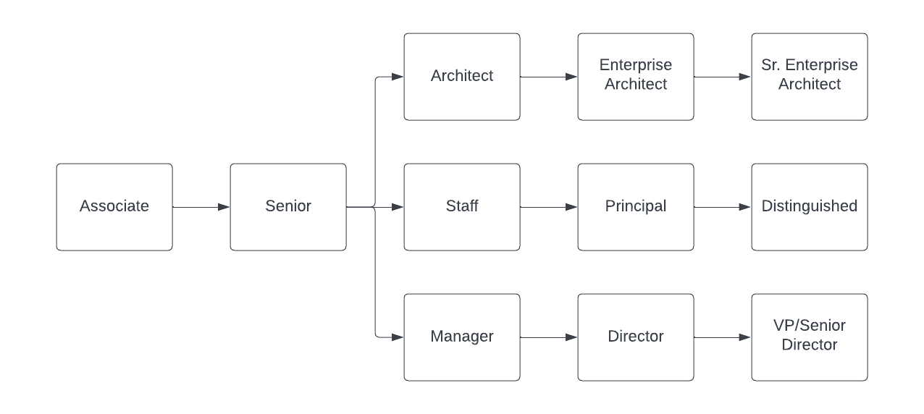
Career Progression

Slide 9
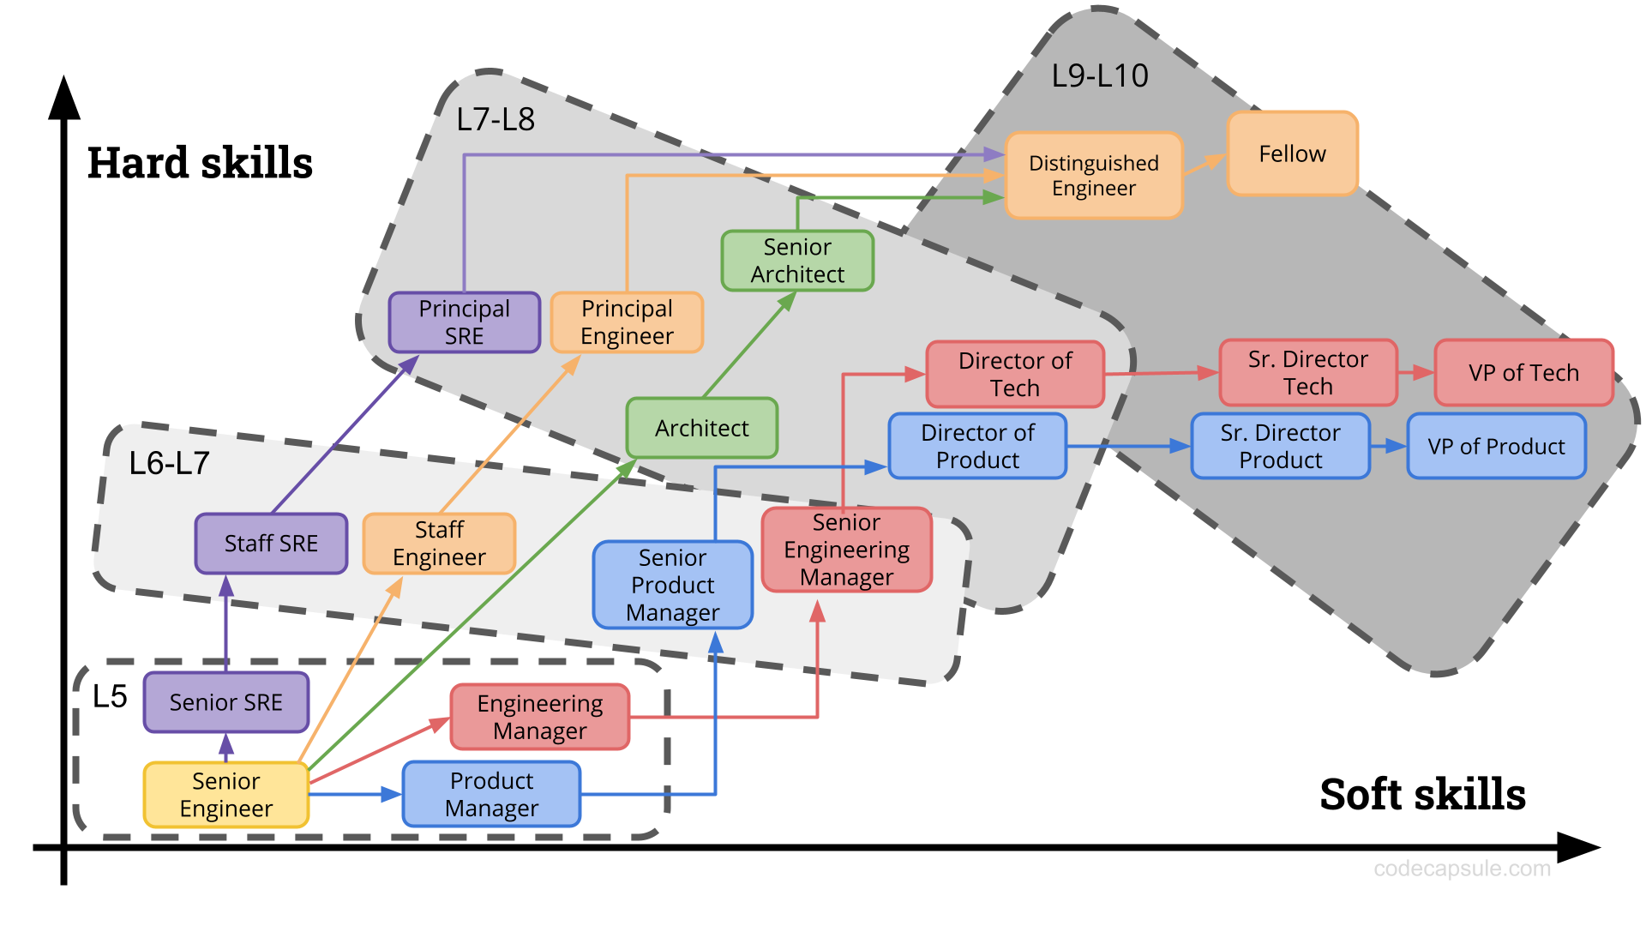

Slide 10
Data Science
Specialized (NLP, Deep Learning, Machine Vision)
Management
Product
Software Engineer

Slide 11
Specialized
Domain expert in one specific problem or solution
Building the models (code or writing requirements)
Individual Contributor (IC) role
Technologies: Jupyter, R Studio, OpenCV
Languages: Python, R, C++

Slide 12
Management
Leading teams of data scientists or entire organizations
Tracking progress towards major objectives
Growing and mentoring people in your organization
Unblocking your team
Skills: Clear communication, time management, humble

Slide 13
Product
Role shift towards developing the actual product
Translating customer needs into technical requirements
Developing the questions the models are built to answer
Skills: Interviewing, Customer Analysis, Psychology

Slide 14
Software Engineer
All roles discussed in the first half of this presentation
The scope of that role is usually in support of a data analysis pipeline
Less academic and more of a “coding” role

Slide 15
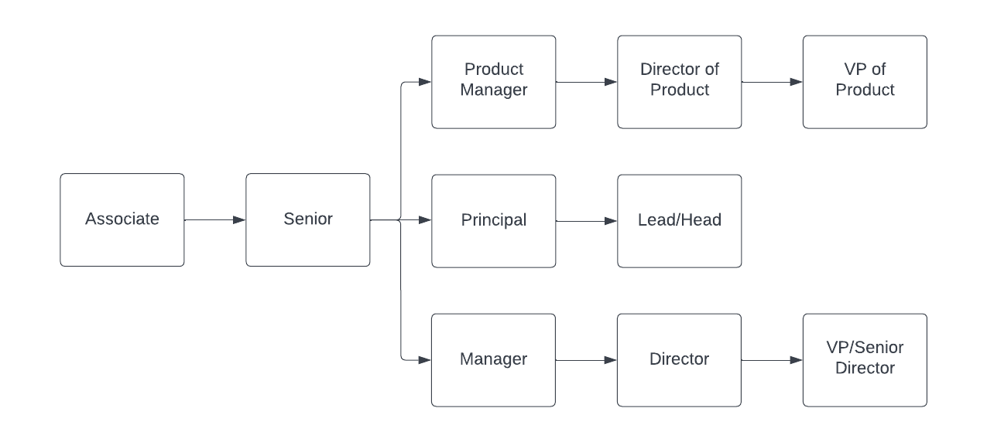
Career Progression

Slide 16
Questions?
Resources:
Hard/Soft Skills Image:
  https://codecapsule.com/2021/07/15/the-skills-map-of-senior-tech-career-progression/
Salary Info:
  www.levels.fyi
  www.teamblind.com (discussion topics as well)
  H1bdata.info (to set your baseline)

